Slide 1

TCS NQT -2026 Hiring

Slide 2
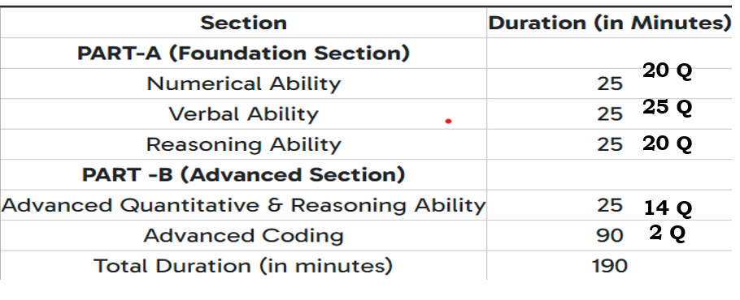
TCS NQT PATTERN-2026

Slide 3

PACKAGE/CTC-2026

Slide 4
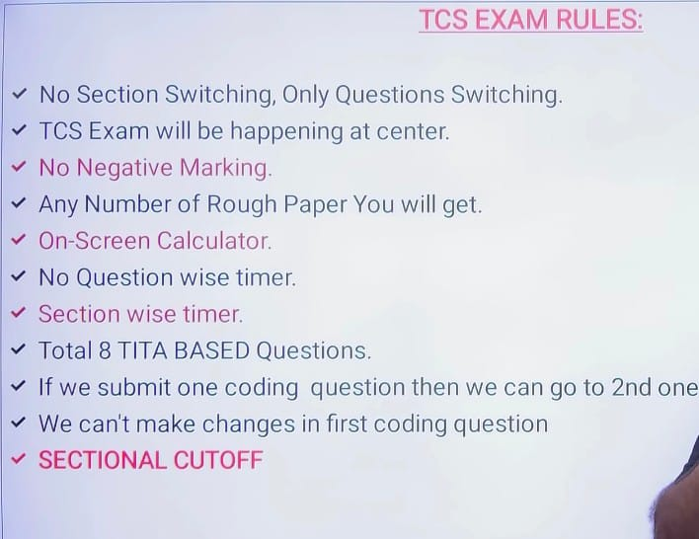
(Fill in the blanks)

Slide 5
APPLICATION PROCESS
Please go through the FAQs before registering
Step 1: Log in to the TCS Next Step Portal
Step 2: Register & Apply for the Drive
Existing Users: Log in with TCS Reference ID → Apply For Drive
New Users: Register Now → Category IT → Apply For Drive
Application form can be filled after test results are declared
Step 3: Select the skill for evaluation
Step 4: Choose In-center test mode & select 3 preferred centers
Test center allocation depends on availability
Step 5: Select 3 preferred job cities
Step 6: Track Your Application → Status: Applied for Drive

Slide 6
Numerical Ability
Number System
LCM & HCF
Divisibility Rules
Simplification & Approximation
Ratio & Proportion
Percentages
Averages
Profit, Loss & Discount
Simple & Compound Interest
Time, Speed & Distance
Time & Work / Pipes & Cisterns
Permutation & Combination
Probability
Mixtures & Allegation
Algebra (basic equations)
Geometry & Mensuration
Statistics

Slide 7
Reasoning Ability
Number Series
Letter Series
Coding–Decoding
Analogy (Word, Number, Alphabet)
Blood Relations
Direction Sense
Ranking / Order Puzzles
Calendar & Clock Problems
Syllogism
Critical Reasoning
Seating Arrangement
Puzzles
Inequalities
Figure based Problems

Slide 8
Verbal Ability
Grammar: Tenses, Articles, Prepositions, Subject–Verb Agreement, Voice, Speech, Error Spotting
Vocabulary: Synonyms, Antonyms, Idioms, One Word Substitution, Spelling Correction
Reading Comprehension: Short passages with inference and vocabulary questions
Sentence Skills: Jumbled Sentences, Sentence Completion Test, Rearrangement

Slide 9
Coding
Basic Programming Concepts: Variables, Data Types, Input/Output, Operators
Control Structures: if–else, loops (for, while, do-while), switch case
Functions & Recursion: Function definition, parameters, return types, recursive logic
Arrays & Strings: Searching, sorting, manipulation operations
Pointers & Memory (C/C++): Basic pointer usage, memory (optional)
Data Structures: Stack, Queue, Linked List (basic), Dynamic programming, Graphs
Logic Building: Pattern printing, simple math problems, number operations

Slide 10
THANK YOU ALL!
All the best…

